Slide 1


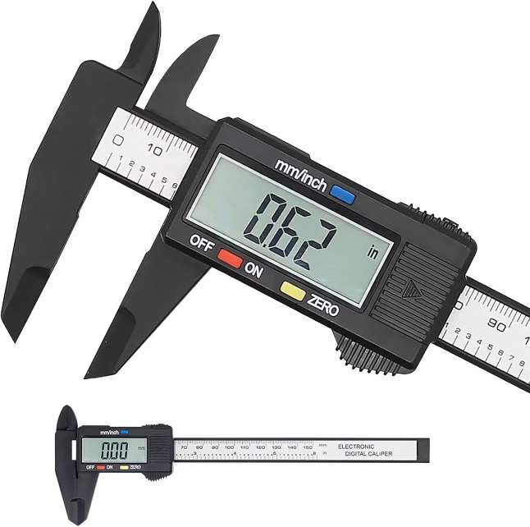
Object Size Measurement in OpenCV
By
M.Akshaya 192221029
M.Nithya 192221073
VP

Slide 2

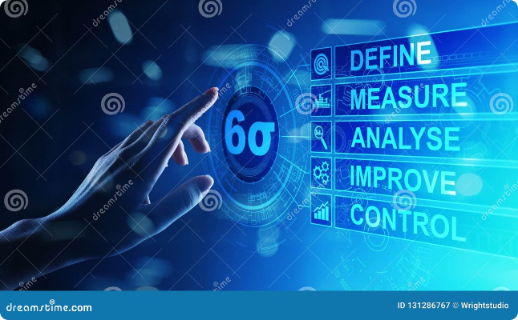
INTRODUCTION
This paper introduces a method for measuring object sizes using OpenCV, an open-source computer vision library. The method can handle variations in image quality, lighting conditions, and background noise without significant loss of accuracy.The method can be applied to a wide range of objects of different shapes, sizes, and materials.

Slide 3
Fundamental Concepts: Pixels, Scaling, and Real-World Dimensions
Pixels
Scaling
Calibration
The basic unit of digital image representation, with no inherent real-world scale.
Relating pixel measurements to real-world units like millimeters or inches.
The process of determining the pixel-to-metric conversion factor for accurate size measurement.

Slide 4

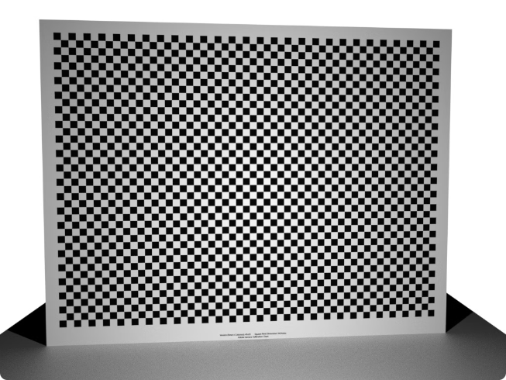
Calibrating the Camera: Determining Pixel-to-Metric Conversion
1
Capture Calibration Image
Take a photo of a known-size calibration pattern, like a checkerboard.
2
Detect Calibration Pattern
Use OpenCV functions to identify the pattern and extract its dimensions in pixels.
3
Calculate Conversion Factor
Divide the real-world size by the pixel size to determine the scaling factor.

Slide 5

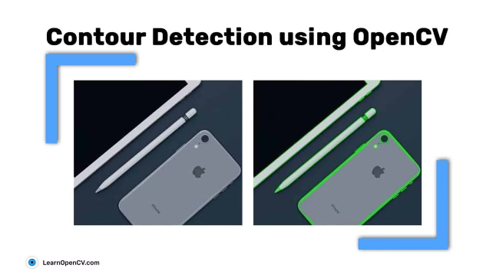
Contour Detection and Bounding Box Extraction
Contour Detection
Bounding Boxes
Use OpenCV's contour finding algorithms to identify the outlines of objects in the image.
Fit tight rectangular boxes around the detected contours to represent object dimensions.
Handling Occlusions
Real-Time Processing
Techniques to deal with objects that are partially hidden or overlapping.
Optimizing the algorithms for fast, efficient object size measurement in video feeds.

Slide 6


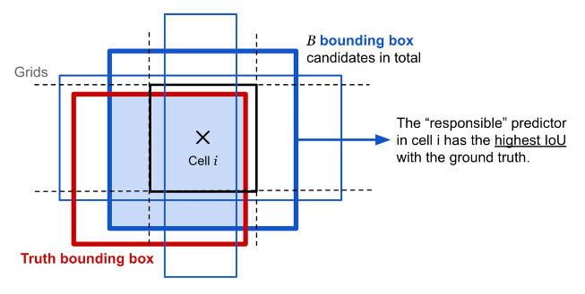


Calculating Object Dimensions Using Bounding Box Properties
Bounding Box Dimensions
Extract the width, height, and area of the bounding box around each object.
Apply Scaling Factor
Use the previously calculated pixel-to-metric conversion to translate the bounding box dimensions to real-world units.
Compute Object Size
Calculate the actual width, height, and volume of the measured objects.

Slide 7
TECHNIQUES
Grayscale Conversion:
Gaussian blur
Adaptive thresholding
Convert the input image to a single-channel grayscale image to simplify further processing.
Apply a Gaussian blur to reduce image noise and detail, making it easier to detect objects.
Convert the blurred grayscale image to a binary image, where the object is highlighted against the background.

Slide 8
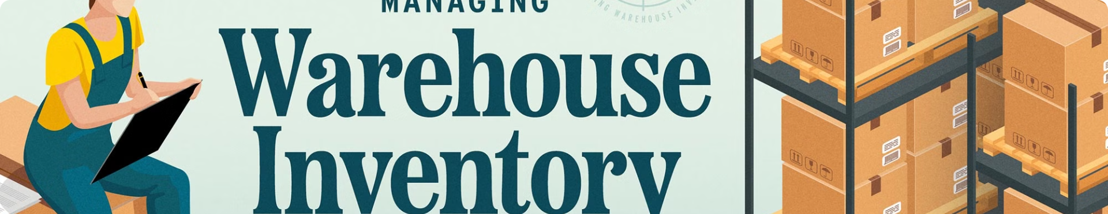




Inventory Management, Quality Control, and More
Manufacturing
Logistics
Robotics
Medical
Ensure consistent product dimensions for quality control.
Optimize box and container sizes for efficient shipping and storage.
Enable autonomous navigation and object manipulation.
Measure anatomical structures for diagnostics and treatment planning.

Slide 9

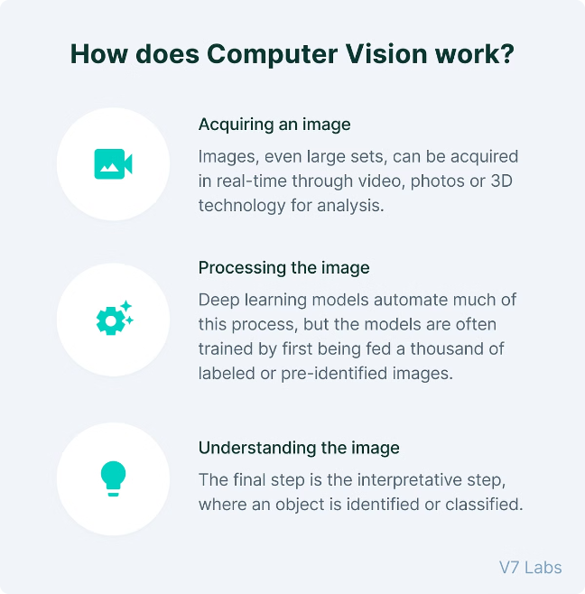
Applications and Limitations in Real-World Scenarios
Agriculture
Measuring the size of fruits, vegetables, and other produce to monitor growth and sort by size for packaging.
Healthcare
Assessing wound sizes or the dimensions of anatomical structures in medical images.
Quality Control
Automated inspection systems in production lines to verify the size and shape of components.
Art and Design
Measuring objects for accurate reproduction in art projects.

Slide 10

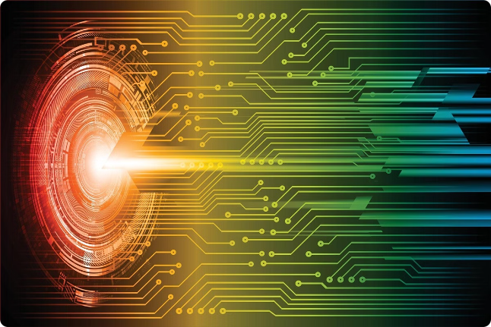
Conclusion and Future Developments
1
Continuous Improvements
2
Emerging Applications
Ongoing research and advancements in computer vision will enhance the accuracy and robustness of object size measurement techniques.
As the technology matures, new use cases will emerge in fields like augmented reality, autonomous vehicles, and smart manufacturing.
3
Combining with Other Technologies
Integrating object size measurement with machine learning, IoT, and big data analytics will unlock even more powerful applications.

Slide 11
THANK YOU

